Slide 1

Market Analysis
Finance & Investing SDG

Slide 2
Table of Contents
01
02
Market events
Discussions
03
04
Market watch
Chat & questions

Slide 3

Market Events
Topics:
1. Wall Street banks fines
2. UK Sterling Shock
3. Apple Stock
Notes:
Bank of England starting quantitative easing again
New “mini”-budget
Tax cuts and energy subsidies funded by borrowing more and creating more government debt through bonds
News made investors dump bonds – increasing yield like crazy and lowering face value of the bond – yield goes up and face value goes down cause the coupon price doesn’t change but the price you pay for the bond goes down – so you pay 50 bucks to get 100 bucks at 2% = 4% for your 50 bucks but still 50% down from 100 dollars to 50 dollars
The drop in face value price of the bond made the UK pension funds sector need to liquidate some securities to not get margin called
If Bank of England didn’t do anything, it could have created a spiral which > sell to not get margin called > lower price > sell more > until whole economy garbage
Bank of England stop their plans to sell their bond holdings (quantitative tightening) and are now buying bonds to keep the price up (quantitative easing)
UK Sterling looks like its in trouble as the bank chooses stability over taming inflation
Turkey doing an oopsie, lowering interest rates as inflation goes crazy
Bond prices going to the floor as interest rates going up

Slide 4
Topic 1
On Tuesday, 16 Wall Street firms were fined a collective $1.8 billion by U.S. Securities Regulators
It was found that employees at various levels have used personal devices and third-party apps to discuss trades, deals, and client meetings.
Off-channel communication has been exacerbated from the pandemic and shift to remote work.
Many of these conversations were later deleted, violating federal laws to preserve all business communications.
Eight of the largest banks settled to pay $125 million each to S.E.C. and $75 million to C.F.T.C.

Slide 5
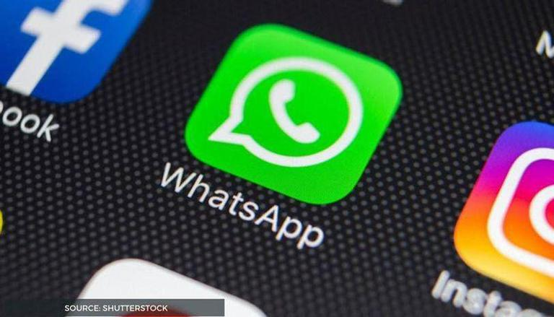

Discussion
Velocity students! Do you remember our compliance talk regarding chatting on WhatsApp? Why is compliance surrounding third-party communication channels important?
Will financial institutions ever be able to fully eliminate off-channel communications?

Slide 6
Topic 2
On Wednesday September 28th (yesterday), the Bank Of England is starting quantitative easing AGAIN
The new mini-budget proposed by the new UK government (cutting taxes and subsidizing energy bills), is creating more inflationary pressure
Too many sellers in the market (UK GOV, BoE, Hedge funds needing liquidity, and investors running from uncertainty.
BoE currently valuing stability over taming inflation
Notes:
Bank of England starting quantitative easing again
New “mini”-budget
Tax cuts and energy subsidies funded by borrowing more and creating more government debt through bonds
News made investors dump bonds – increasing yield like crazy and lowering face value of the bond – yield goes up and face value goes down cause the coupon price doesn’t change but the price you pay for the bond goes down – so you pay 50 bucks to get 100 bucks at 2% = 4% for your 50 bucks but still 50% down from 100 dollars to 50 dollars
The drop in face value price of the bond made the UK pension funds sector need to liquidate some securities to not get margin called
If Bank of England didn’t do anything, it could have created a spiral which > sell to not get margin called > lower price > sell more > until whole economy garbage
Bank of England stop their plans to sell their bond holdings (quantitative tightening) and are now buying bonds to keep the price up (quantitative easing)
UK Sterling looks like its in trouble as the bank chooses stability over taming inflation
Mini-budget link
https://en.wikipedia.org/wiki/September_2022_United_Kingdom_mini-budget#:~:text=The%20key%20points%20announced%20in,Northern%20Ireland%20from%20April%202023
- Mostly tax cuts and cutting funding for public services

Slide 7
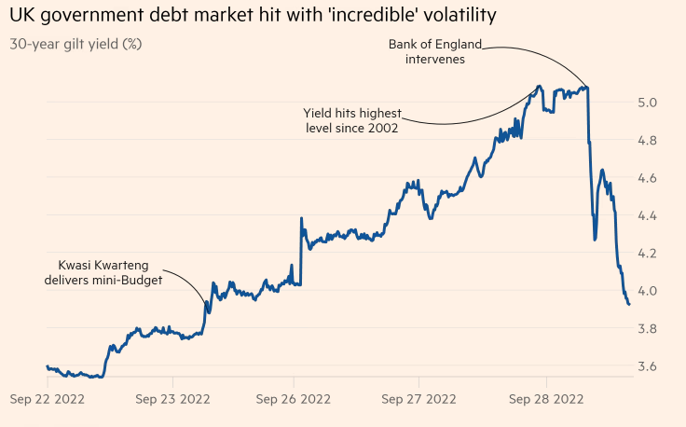
Discussion
Why do yields go up on bonds when people are selling it?
And the opposite when people are buying it?
Source: https://www.ft.com/content/4e6b89a3-a63e-49df-8a04-0488b69e84f5
Notes:
Bank of England starting quantitative easing again
New “mini”-budget
Tax cuts and energy subsidies funded by borrowing more and creating more government debt through bonds
News made investors dump bonds – increasing yield like crazy and lowering face value of the bond – yield goes up and face value goes down cause the coupon price doesn’t change but the price you pay for the bond goes down – so you pay 50 bucks to get 100 bucks at 2% = 4% for your 50 bucks but still 50% down from 100 dollars to 50 dollars
The drop in face value price of the bond made the UK pension funds sector need to liquidate some securities to not get margin called
If Bank of England didn’t do anything, it could have created a spiral which > sell to not get margin called > lower price > sell more > until whole economy garbage
Bank of England stop their plans to sell their bond holdings (quantitative tightening) and are now buying bonds to keep the price up (quantitative easing)
UK Sterling looks like its in trouble as the bank chooses stability over taming inflation
Mini-budget link
https://en.wikipedia.org/wiki/September_2022_United_Kingdom_mini-budget#:~:text=The%20key%20points%20announced%20in,Northern%20Ireland%20from%20April%202023
- Mostly tax cuts and cutting funding for public services

Slide 8
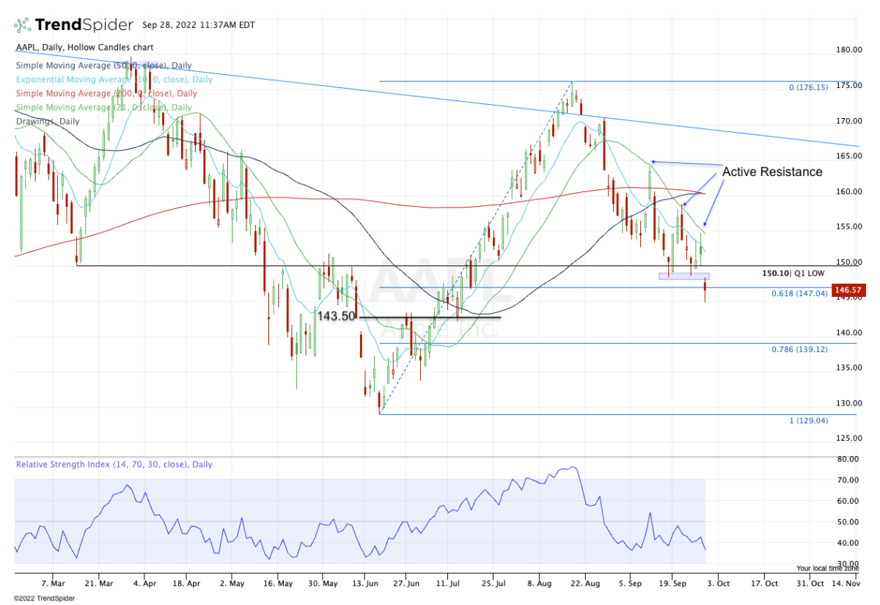
Topic 3 (According to Thestreet.com)
Apple give up the plan to increase producing iPhone to 6 million for the second half year, many customers indicate that they prefer buying iPhone 13 compared to the new one
APPLE(APPL) share futures drop by 3%,-3.97% Wednesday after the announcement
Apple's close price is $33 below 52 week high($181.26 on January, 2022).
https://www.thestreet.com/investing/iphone-report-sends-apple-below-key-support-check-chart?puc=yahoo&cm_ven=YAHOO
Notes:
Although Apple's stock is still 17.5% up from its 2022 low on Tuesday when the market closed,
it falls by 1.3% on Wednesday. Although it was performing well on Tuesday compared to S&P's,
Now that with the intervention of BoE, the stock is not performing as well compared to its competitors(microsoft, google), underperforming in the market.

Slide 9
Discussion
What do you think would be the prospective for iPhone 15? The consumer electronic industry overall?
How would you forecast in the Apple's stock value(+/-)?

Slide 10
Market watch
Wednesday
Wednesday
Friday
Upcoming Canadian events to look out for over the next week …
Imports & Exports for August
10-Year Bond Auction
Unemployment Rate for September

Slide 11

Thanks for joining us!
Any questions? Let’s chat!

